Slide 1


Slide 2

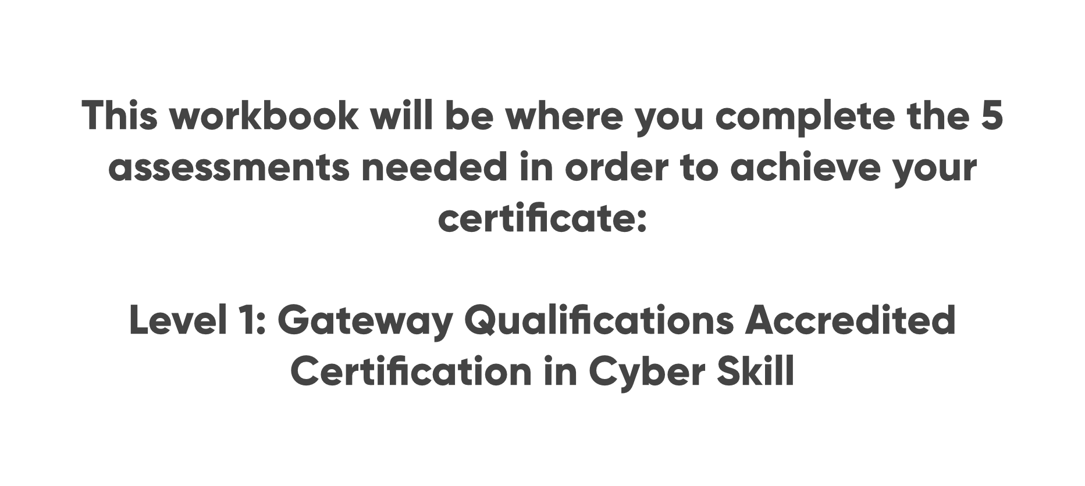

Slide 3
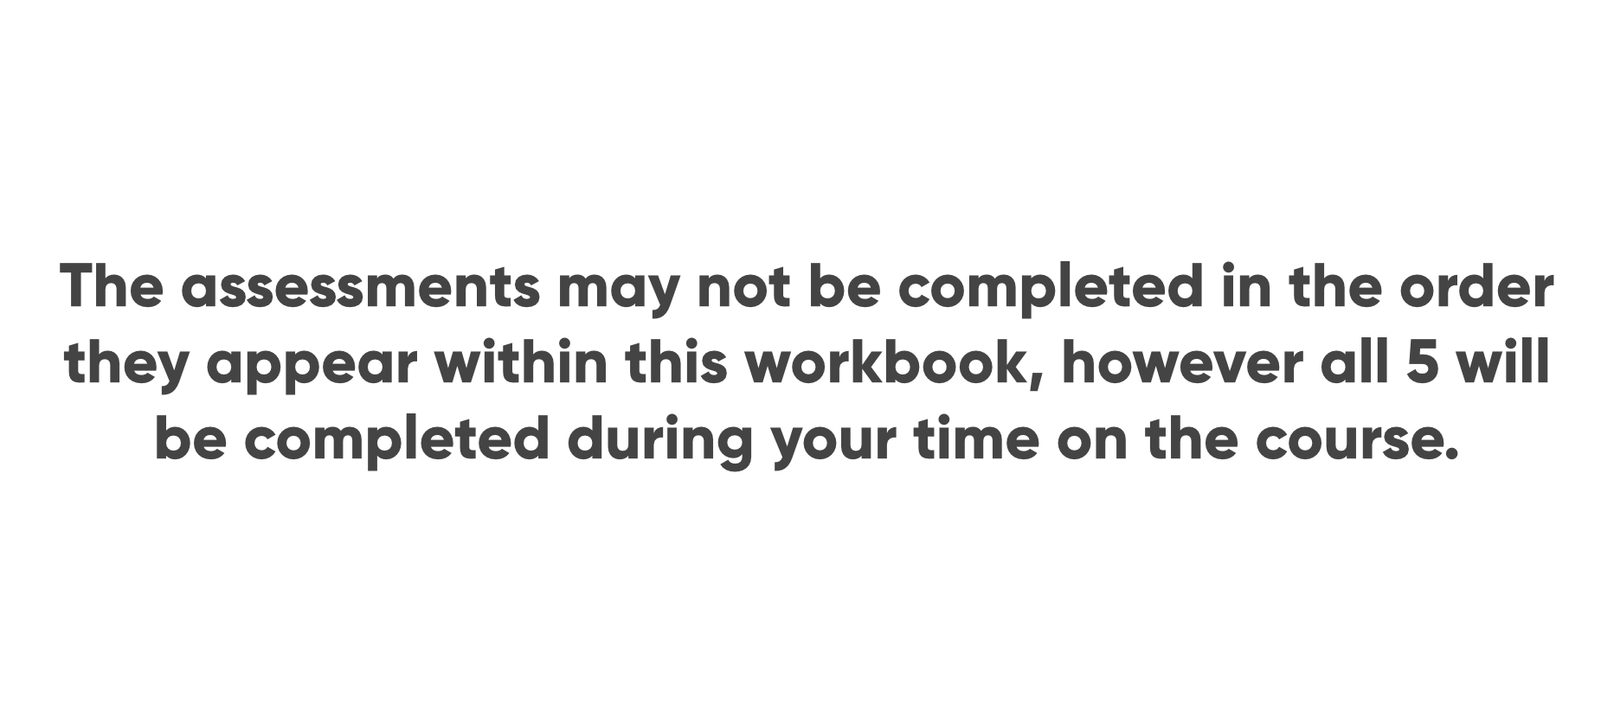

Slide 4
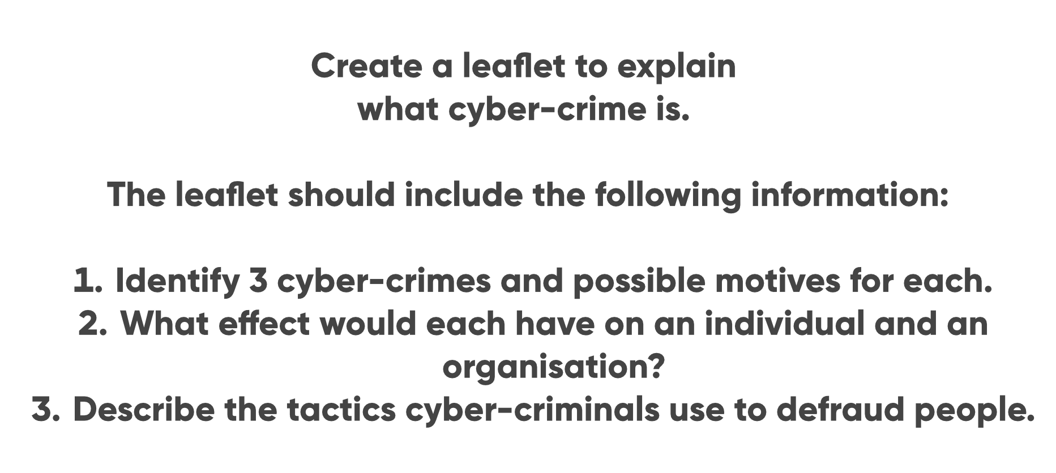

Slide 5
Cyber-crimes are the act of exploiting human or security weaknesses to cause harm or steal data.
Phishing – Financial Gain,
DoS – Recognition/Fear/Financial Gain,
Malware – Recognition/Control/Financial Gain/Fear

Slide 6
Phishing is usually done via emails, that are made to look legitimate, but are trying to gain personal information and/or bank details.
DoS attacks are designed to make a website or other online service unavailable or unusable to other users.
Malware is code designed to interfere with a device or network’s normal functionality (includes trojans, viruses, spyware, ransomware).
Cyber-criminals use phishing, social engineering, ransomware, identity theft and crypto scams. These are just some of the tactics used.

Slide 7
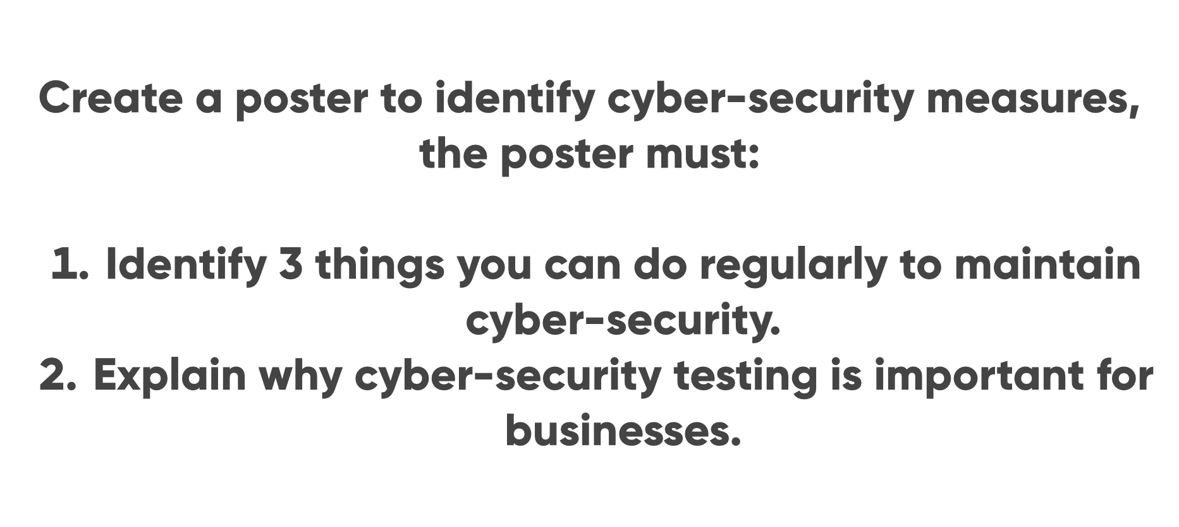

Slide 8
Maintaining Cyber-Security
Cyber-Security Testing
Being Careful
where you share personal information, links that you click and anything that you download.
Browser Safety
make sure the websites visited use https instead of http.
Password Safety
use different passwords for each website/app. Protect passwords by using a password manager.
To test an IT system, network or web application to find security vulnerabilities.
To measure effectiveness of security
To reduce the possibility for intruders to get unauthorised access.

Slide 9


Slide 10


Slide 12
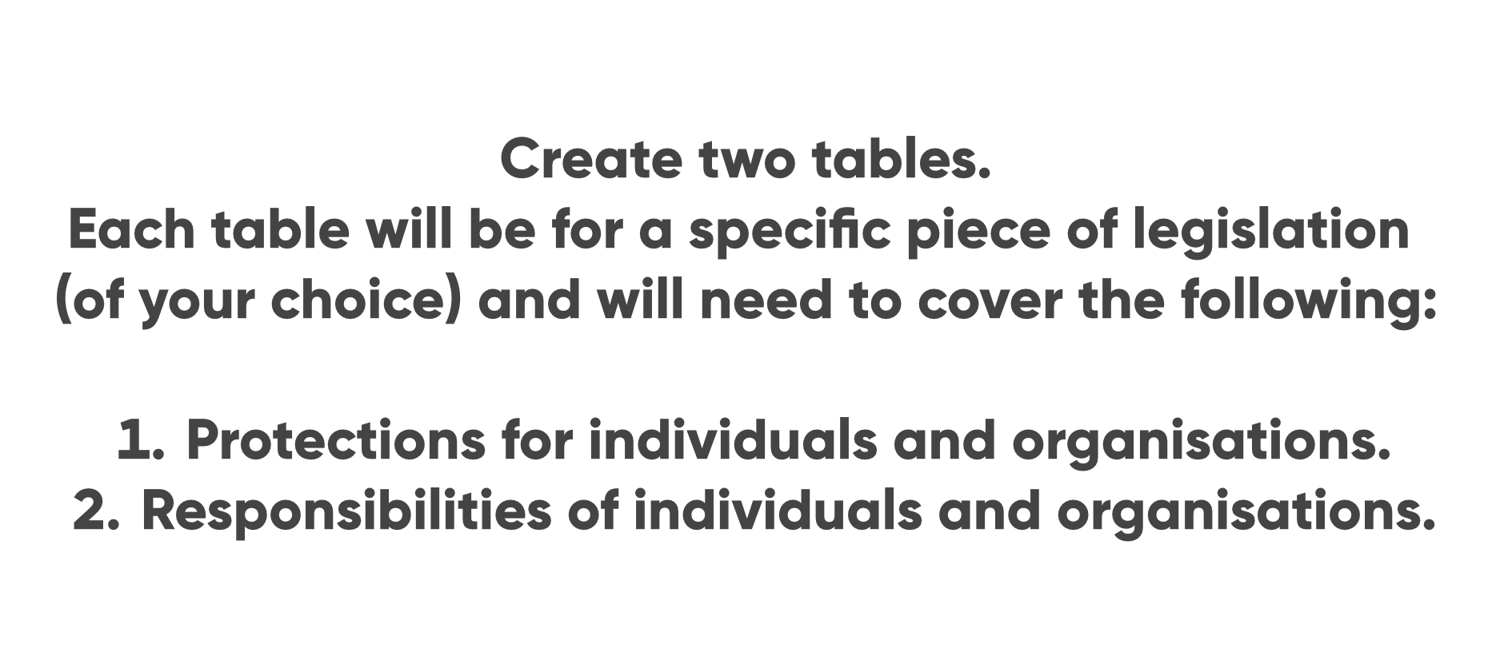

Slide 13
Data Protection Act 2018
How personal information is used
Make sure information is used fairly, lawfully and transparently
How Personal information is stored
Storage Limitations
Ensure appropriate security against unauthorized processing, access, loss, destruction or damage

Slide 14
Computer Misuse Act 1990
Protect personal data held, from unauthorized attacks and modification.
To not access unauthorized computer material
To not access computer materials with intent to commit crime
Making, supplying or obtaining anything which can be used in computer misuse offences is prohibited

Slide 15
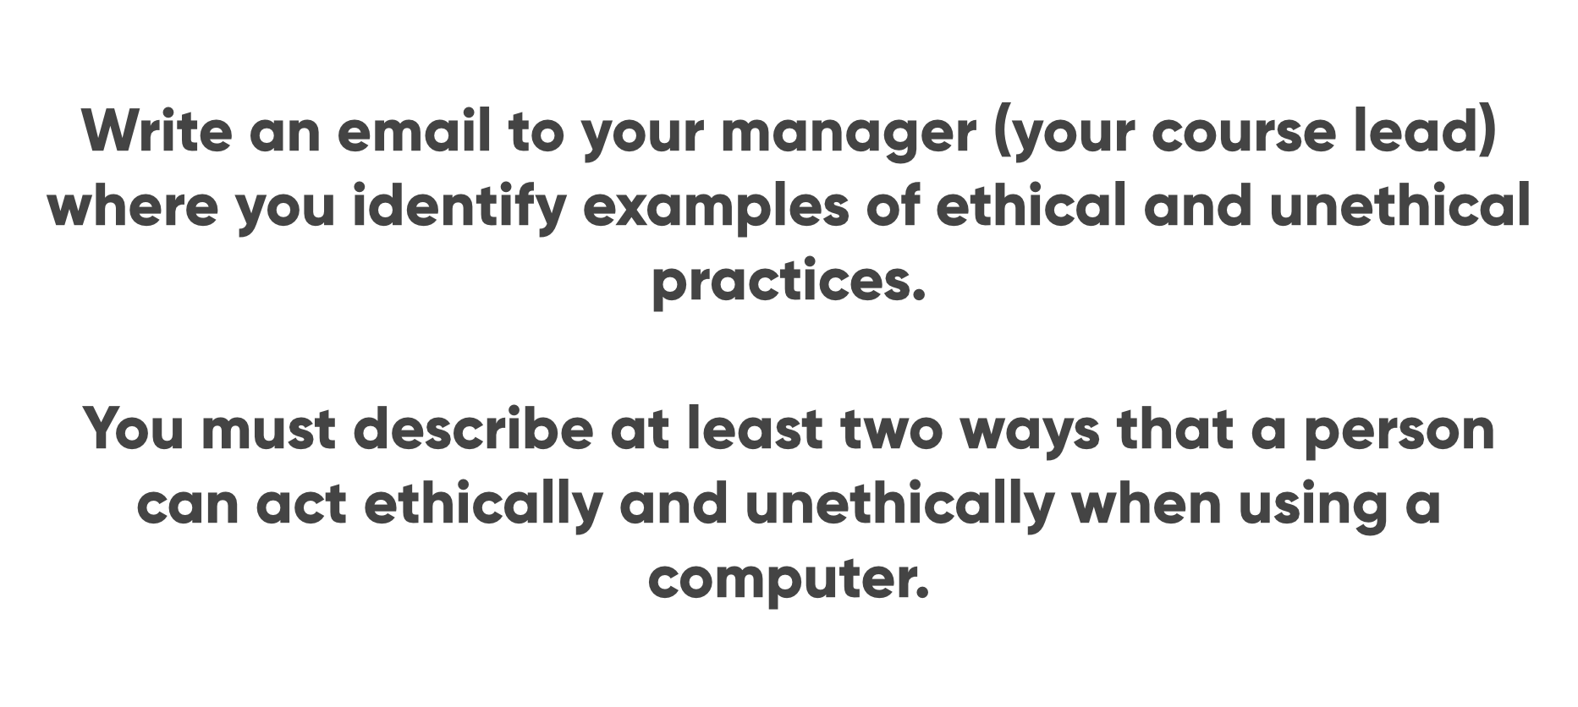

Slide 16

Ethical and Unethical Practices
Ethical Practices
Integrity
Protecting the privacy of individuals, which means that any data that is collected should be done so with the explicit consent of the person or organisation. Data collected should be stored securely, and not shared without consent.
Professionalism
Transparency about what kind of data an organisation collects and why they need it. Organisations must make sure their users know what type of information they are collecting and how it will be used before asking for consent to collect it, and then only use this data for the purposes stated.
Unethical Practices
Unethical practices would be practices that oppose the above. Not letting the users know what type of data is being collected,not asking for consent and/or sharing the users’ data.

